Slide 1
N4 - SOLID PROPULSION PROGRESS
Week 3

Slide 2
WEEK OBJECTIVES
Design and 3D printing of Casting tools
Nozzle simulation (ANSYS)
Motor casing design
Research on grain storage
Bill of material
Redesign of ignition circuit

Slide 3
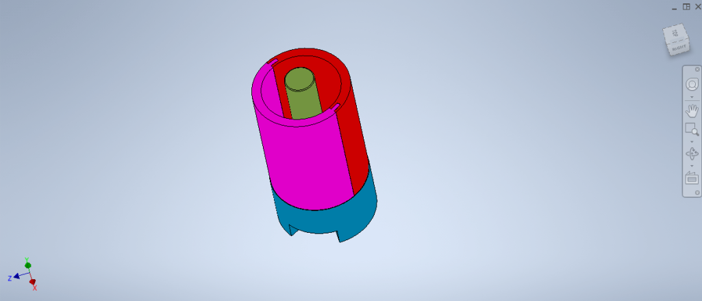
B. TASKS DONE
Design and 3D printing of the casting tools
a. Design of the casting tools using SOLIDWORKS

Slide 4
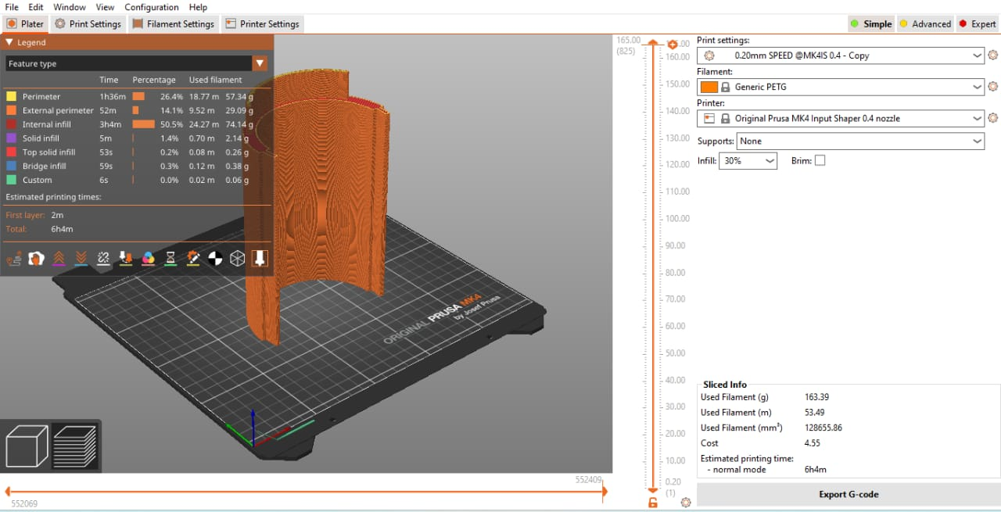
b. Slicing of the casting tools using PRUSA
PRUSA

Slide 5
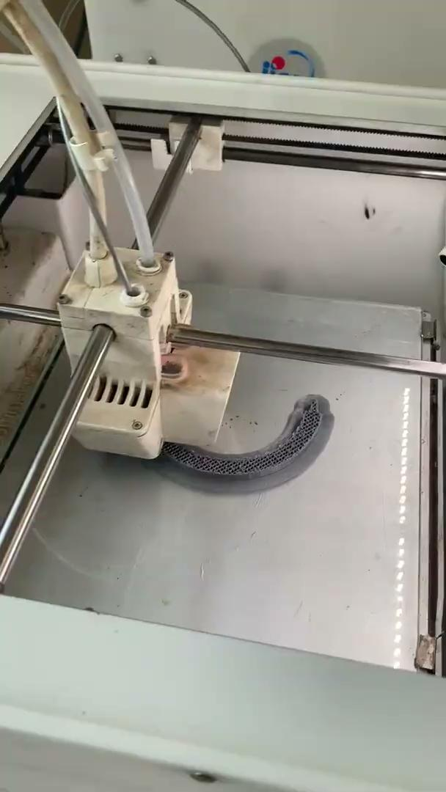
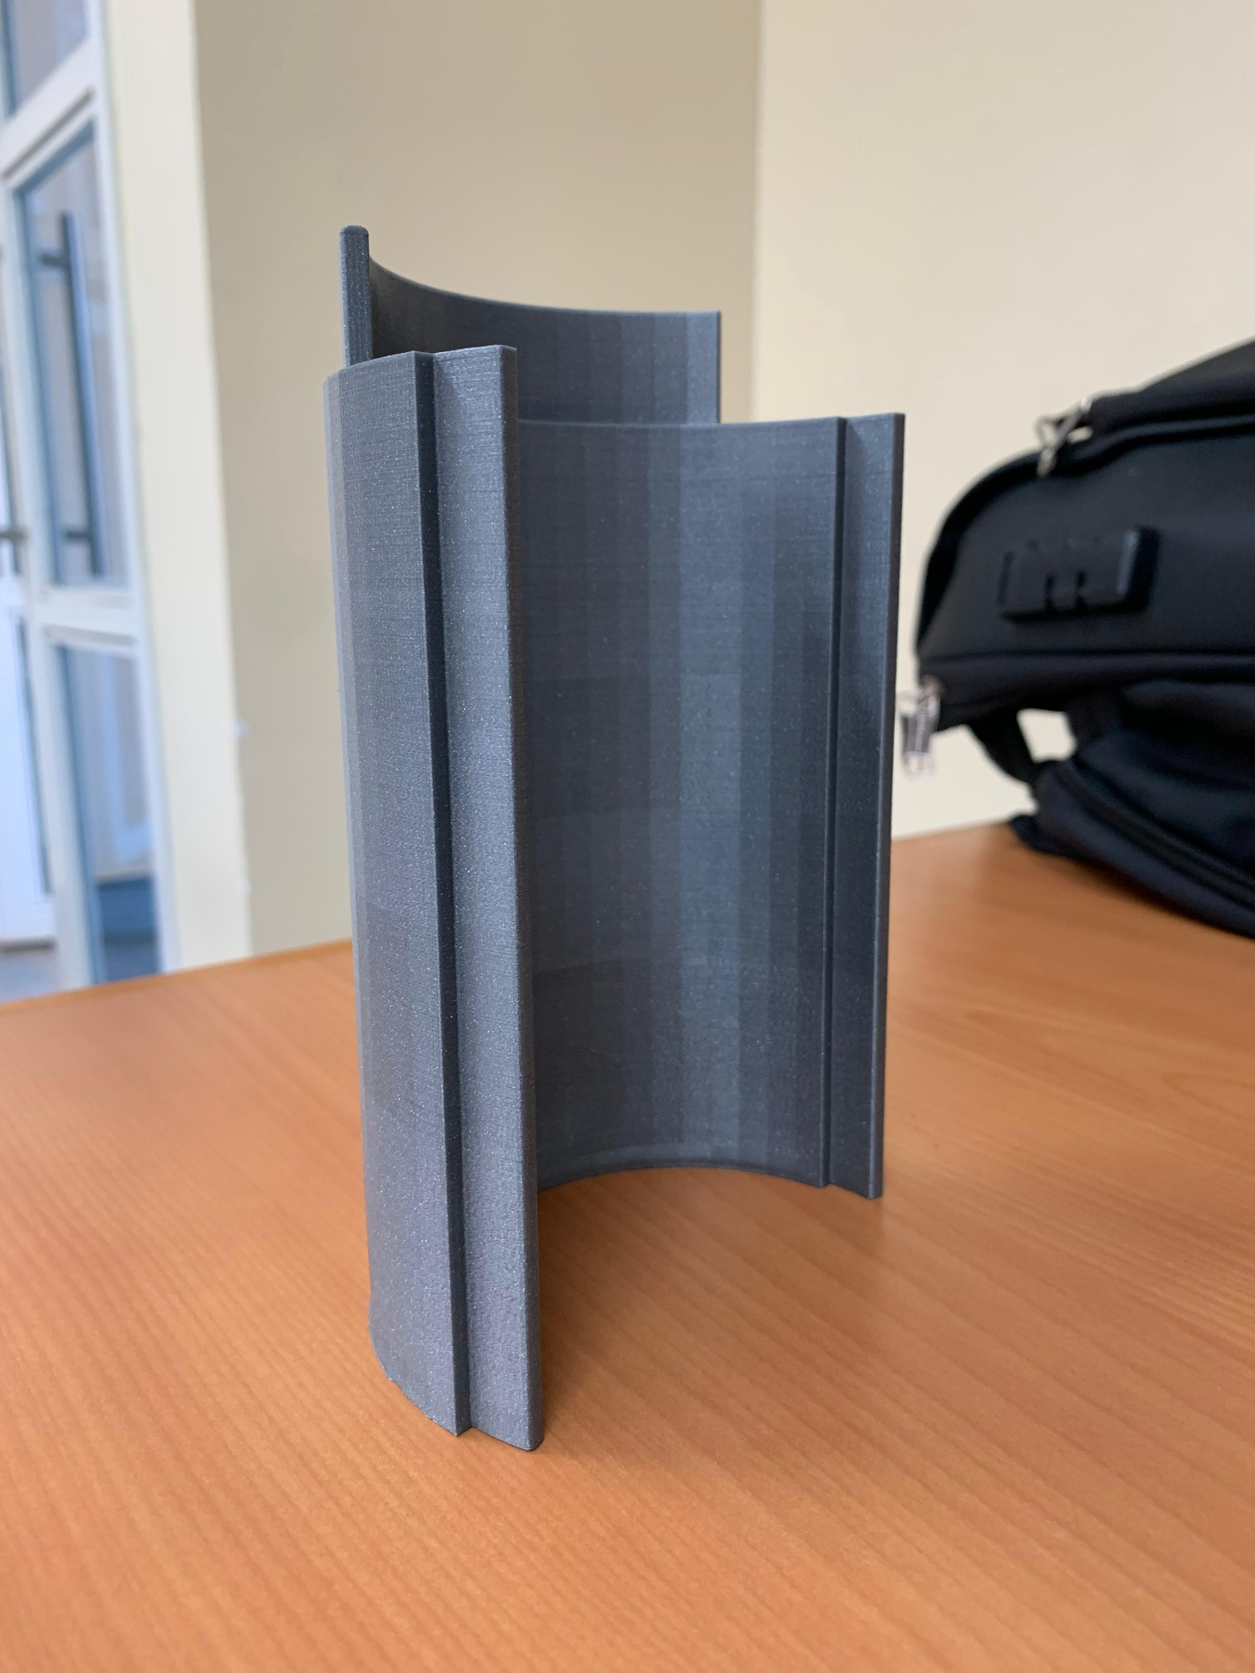
c. 3D Printing of the casting tools
ONE PART DONE

Slide 6
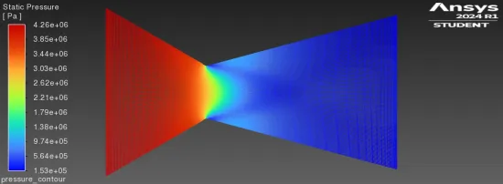
2. Nozzle simulation
a. Pressure
Map

Slide 7
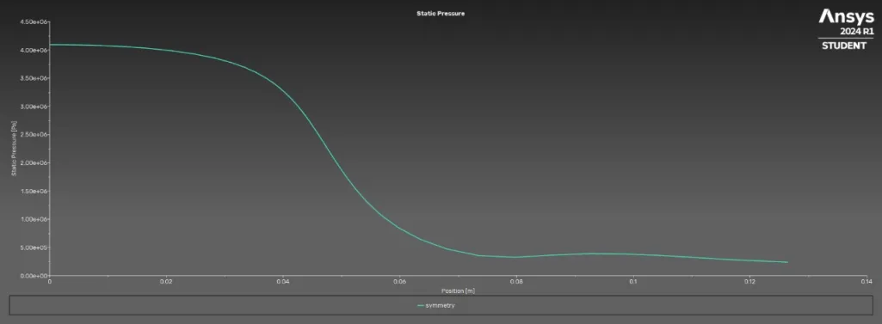
2. Nozzle simulation
a. Pressure
Map

Slide 8
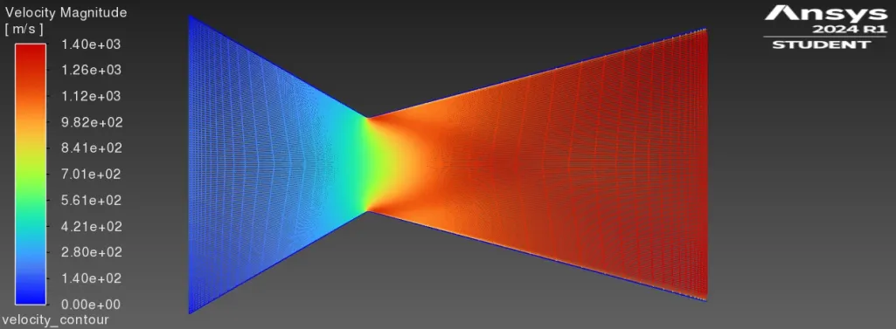
2. Nozzle simulation
b. Velocity
Map

Slide 9
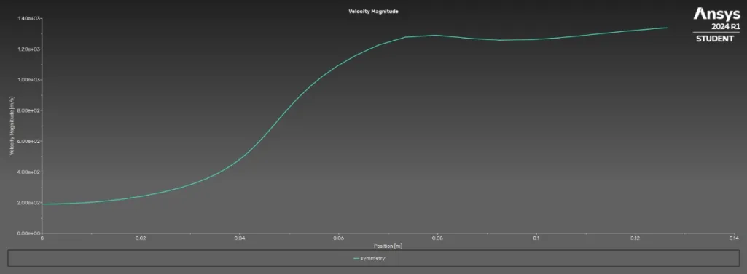
2. Nozzle simulation
b. Velocity
Plot

Slide 10
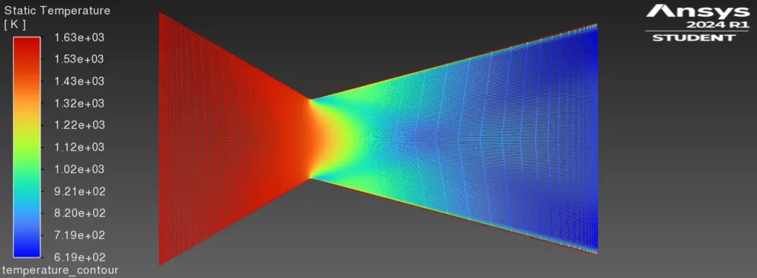
2. Nozzle simulation
c. Temperature
Map

Slide 11
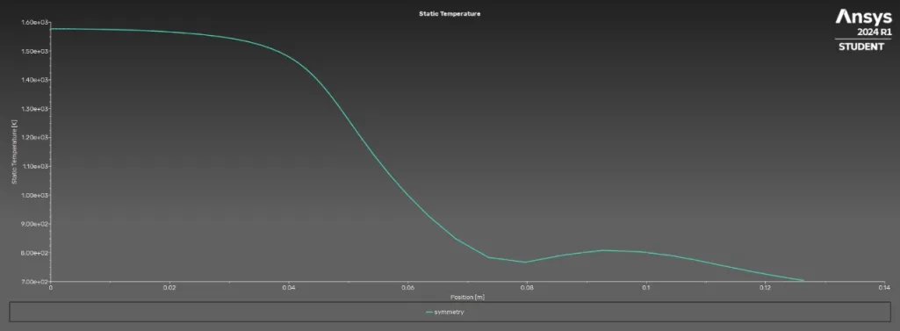
2. Nozzle simulation
c. Temperature
Plot

Slide 12
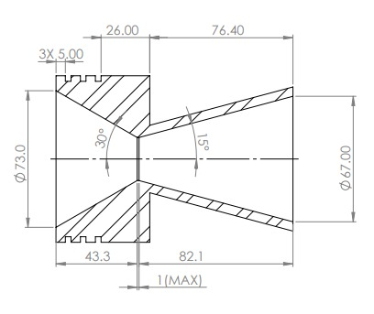
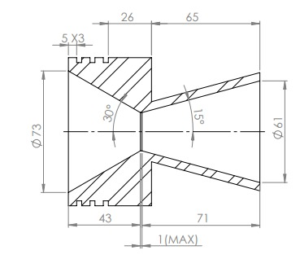
d. Nozzle redesigned after simulations
INITIAL DESIGN
REDESIGNED NOZZLE

Slide 13
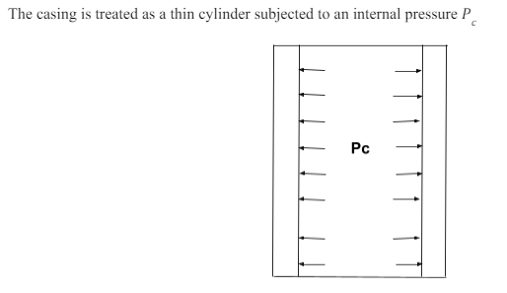
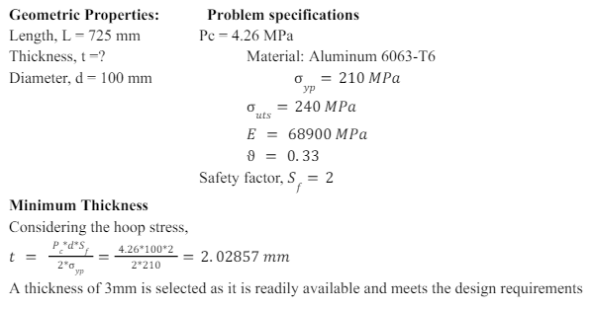
3. Motor casing design

Slide 14
4. Grain storage
Molecular Sieves- effectively at low humidity levels, expensive
Activated Alumina(Al(OH)3)- porous, good moisture absorption capacity. fragile and prone to crushing
CaSO4- does not form liquid when saturated, low moisture absorption capacity.
CaCl2- (suggested in Richard Nakka). absorb moisture effectively, quite reactive, forms liquid brine with moisture. Concentrated solution is corrosive
Silica Gel- Inert, effective moisture absorption, no liquid formation, easy to handle, non-toxic
https://1drv.ms/w/s!Aq_-ZEYiFHccsRXqFwWScMQ3fxAJ?e=92ZWR1

Slide 15
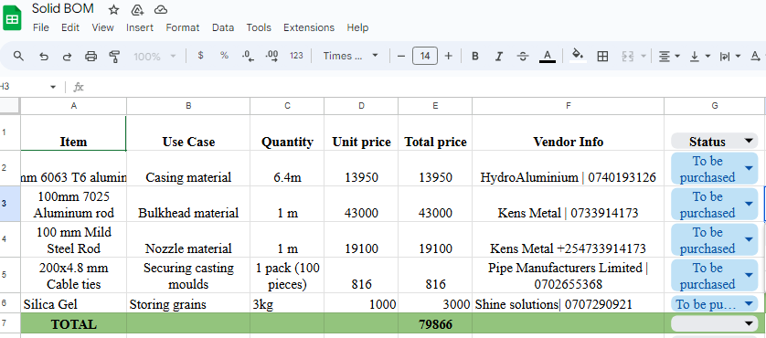
5. Bill of material

Slide 16
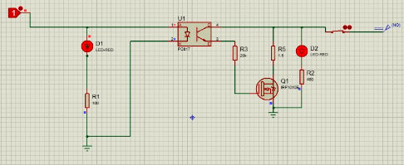
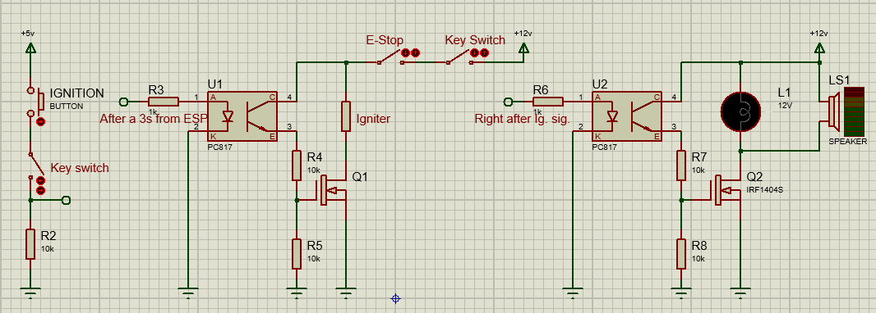
6. Ignition Circuit Improved
IGN CRCT N3.5
IGN CRCT N4

Slide 17
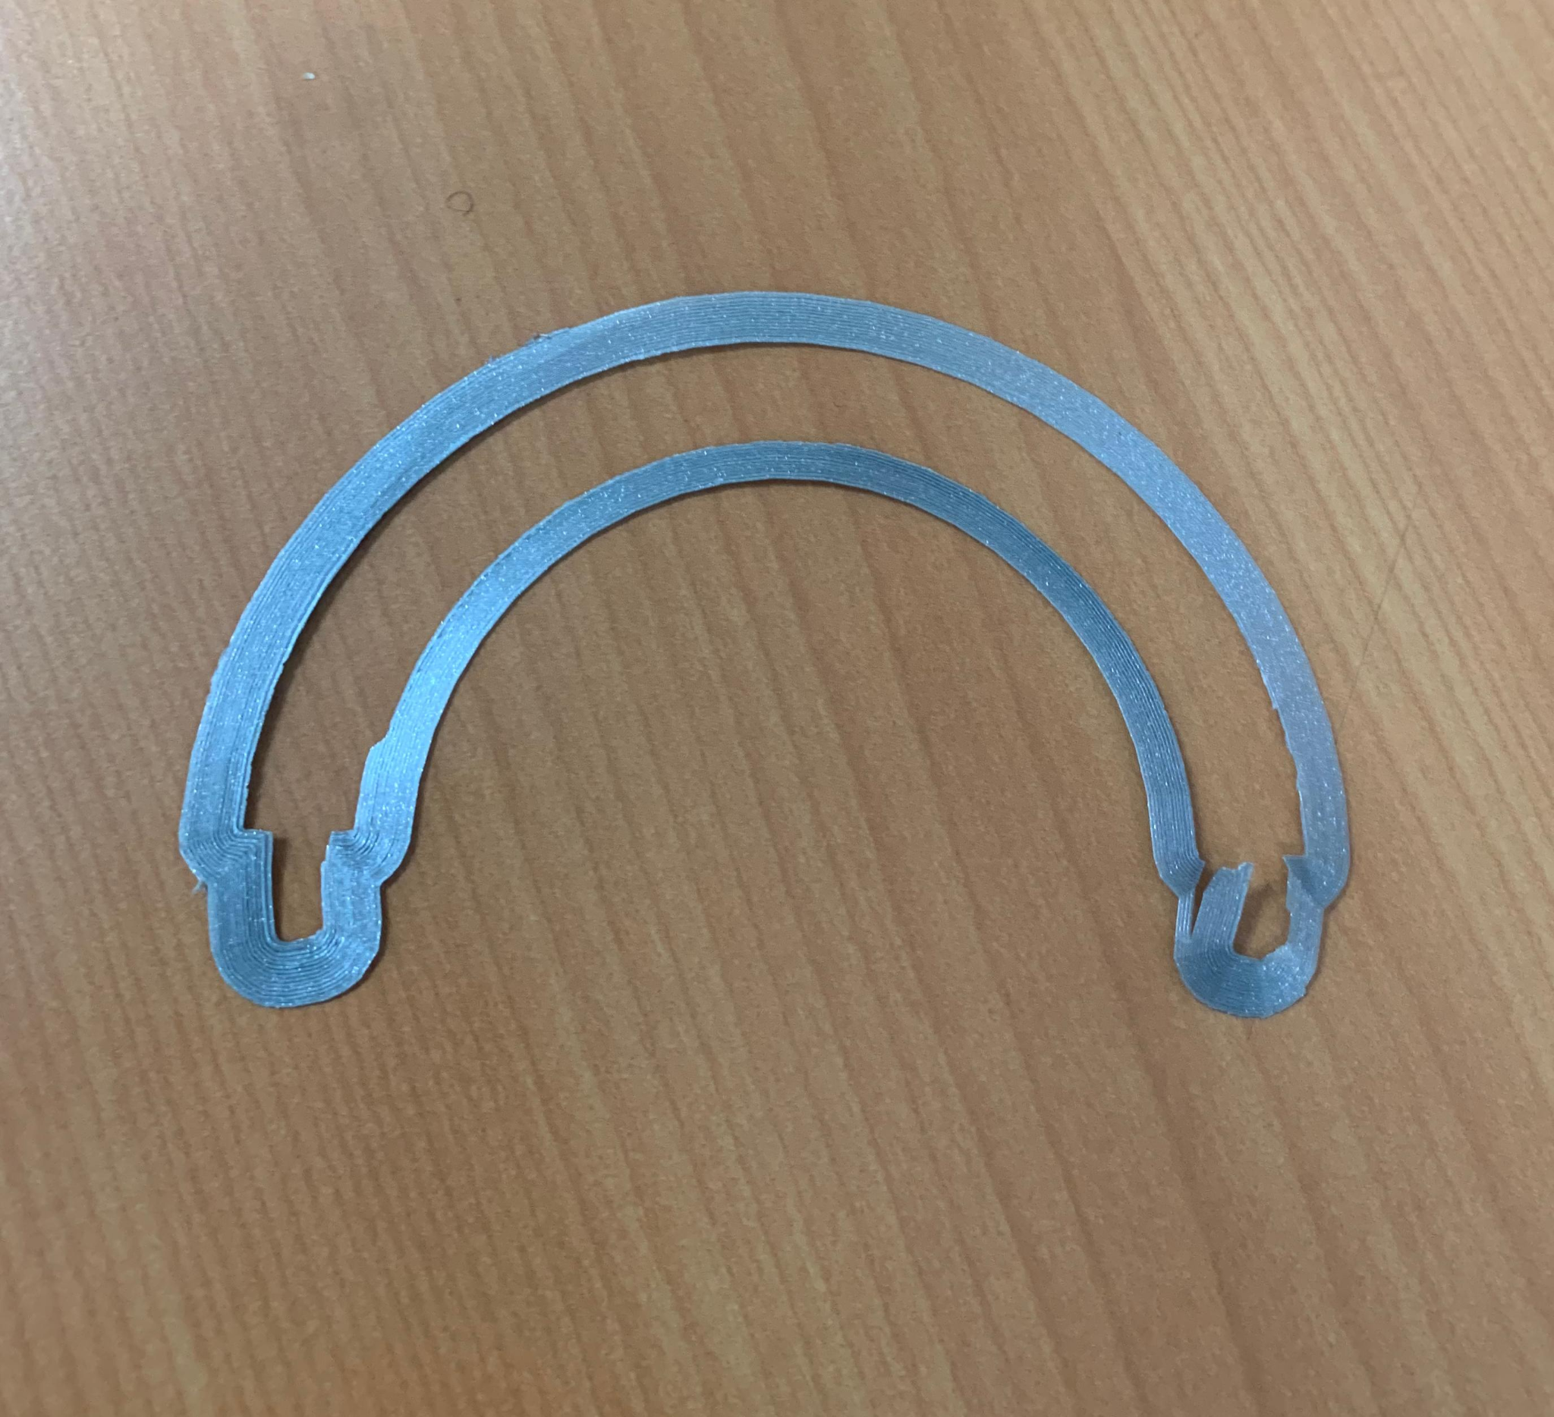
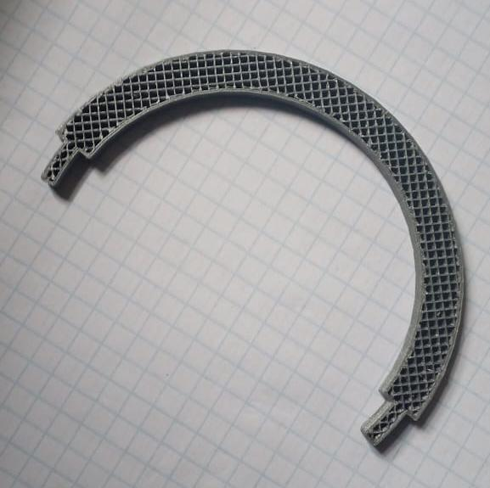
C. CHALLENGES
3D printing failures due to unclean printer nozzle and power interruptions
Result due to unclean nozzle
Result due to power interruptions

Slide 18
D. NEXT WEEK OBJECTIVES
Procurement of the materials
Machining of the nozzle, the bulkhead and the motor casing
Cooking of the grain
Fabrication of the ignition circuit
Complete the test stand design and its fabrication

Slide 19
Arigatō🙏

